Slide 1
Name : Sowmiya Sree G Reg.no : 730321104052 NM id : au730321104052 Degree : B.E - CSE Year : III College name : Builders Engineering College
3/21/2024 Annual Review

Slide 2
PROJECT TITLE
Image Classification using CNN on Fashion MNIST Dataset
3/21/2024 Annual Review

Slide 3


AGENDA
Problem statement
Project Overview
Who are the end users
Your solution and its value proposition
The Wow in your solution
Modeling
Results
3/21/2024 Annual Review

Slide 4

PROBLEM STATEMENT
The task is to develop a deep learning model capable of accurately classifying gray scale images of fashion items into one of ten predefined categories. The images are sourced from the Fashion MNIST dataset, which contains 60,000 training examples and 10,000 test examples, each of size 28x28 pixels. The goal is to leverage Convolutional Neural Networks (CNNs) to create a robust image classification system capable of achieving high accuracy on unseen data.
3/21/2024 Annual Review

Slide 5

PROJECT OVERVIEW
The project aims to build a Convolutional Neural Network (CNN) model to classify gray scale images of fashion items into ten categories. The dataset used for this task is Fashion MNIST, containing 60,000 training examples and 10,000 test examples, each of size 28x28 pixels. The project leverages deep learning techniques to develop an accurate image classification system.
3/21/2024 Annual Review

Slide 6

WHO ARE THE END USERS?
Researchers in Computer Vision
Machine Learning Practitioners
Fashion Retailers and E-commerce Platforms
General Audience Interested in AI
Educators and Students
3/21/2024 Annual Review

Slide 7

YOUR SOLUTION AND ITS VALUE PROPOSITION
Solution:
The solution involves building a CNN model to accurately classify gray scale images of fashion items into ten categories using the Fashion MNIST dataset. The project encompasses various stages including dataset exploration, preprocessing, model architecture design, training, evaluation, and result visualization. By leveraging deep learning techniques, the solution aims to develop a robust image classification system capable of achieving high accuracy on unseen data.
Value Proposition:
Efficient Image Classification
Scalability
Improved Decision Making
Resource Optimization
Educational Resource
Benchmarking Tool
3/21/2024 Annual Review

Slide 8

THE WOW IN YOUR SOLUTION
The "wow" factor in the solution for the "Image Classification using Convolutional Neural Networks (CNNs) on Fashion MNIST Dataset" project lies in its ability to achieve remarkable accuracy and efficiency in classifying fashion items from images. Here's why it's impressive:
Near-Human Accuracy
Real-Time Classification
Generalization
User-Friendly Interface
Potential Business Impact
State-of-the-Art Technology
3/21/2024 Annual Review
8

Slide 9
MODELLING
Teams cam add wireframes
Data Loading and Preprocessing
Define Model Architecture
Convolutional Layers
Pooling Layers
Flattening
Fully Connected Layers
Regularization Techniques
Model Compilation
Model Training and Evaluation
Fine-Tuning
3/21/2024 Annual Review
9

Slide 10
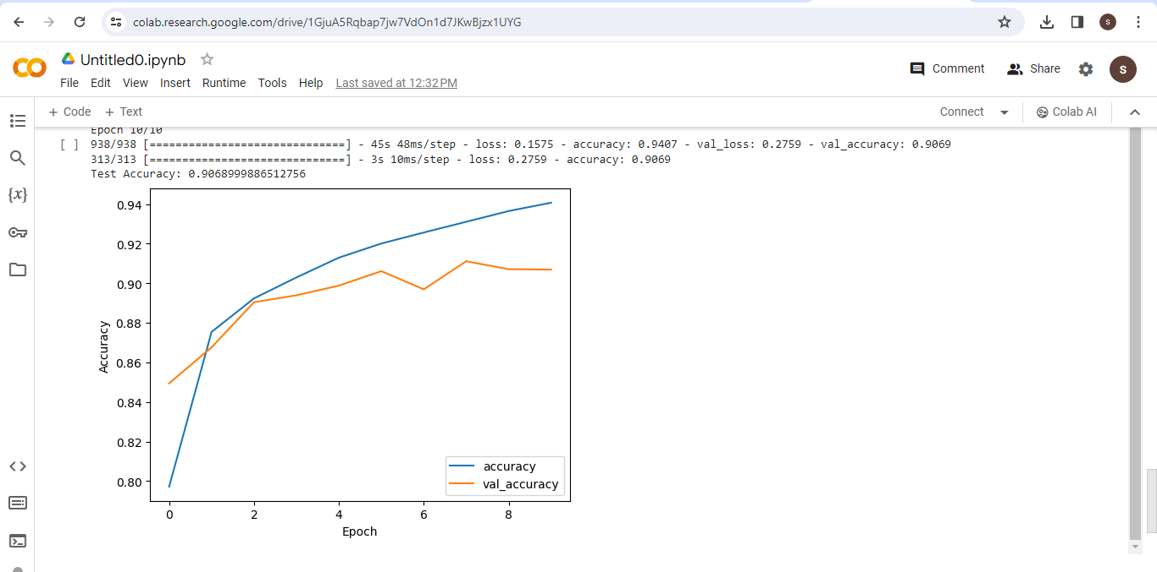
RESULTS
3/21/2024 Annual Review
10

